Slide 1
Evolutionary Algorithms II
Prof Ender Ozcan

Slide 2

Outline
Questions…
Benchmark Functions
Benchmark Functions Experiments
Travel Salesman Problem
Permutation Based Operator
Multimeme Memetic Algorithm
Benchmark Functions Exp. - Revisited

Slide 3
Learning Outcomes
Be able to identify different types of EAs
Understand the potential issues with the choice of representation (in particular permutation representation) in relation to the choice of genetic operators
Understand the basic components of Multimeme Memetic Algorithms and the concepts of self-adaptation/self-generation – learning the jargon
Be able to design and apply a Genetic/(Multimeme) Memetic Algorithm to an “unseen” problem

Slide 4
Questions
When does a genetic algorithm perform better than a memetic algorithm?
Is the choice of meme (hill climbing/local search algorithm) important?
Which meme does have a better performance in a memetic algorithm?
Can we somehow combine several memes to obtain a synergy leading to improved performance?

Slide 5
Benchmark Functions

Slide 6
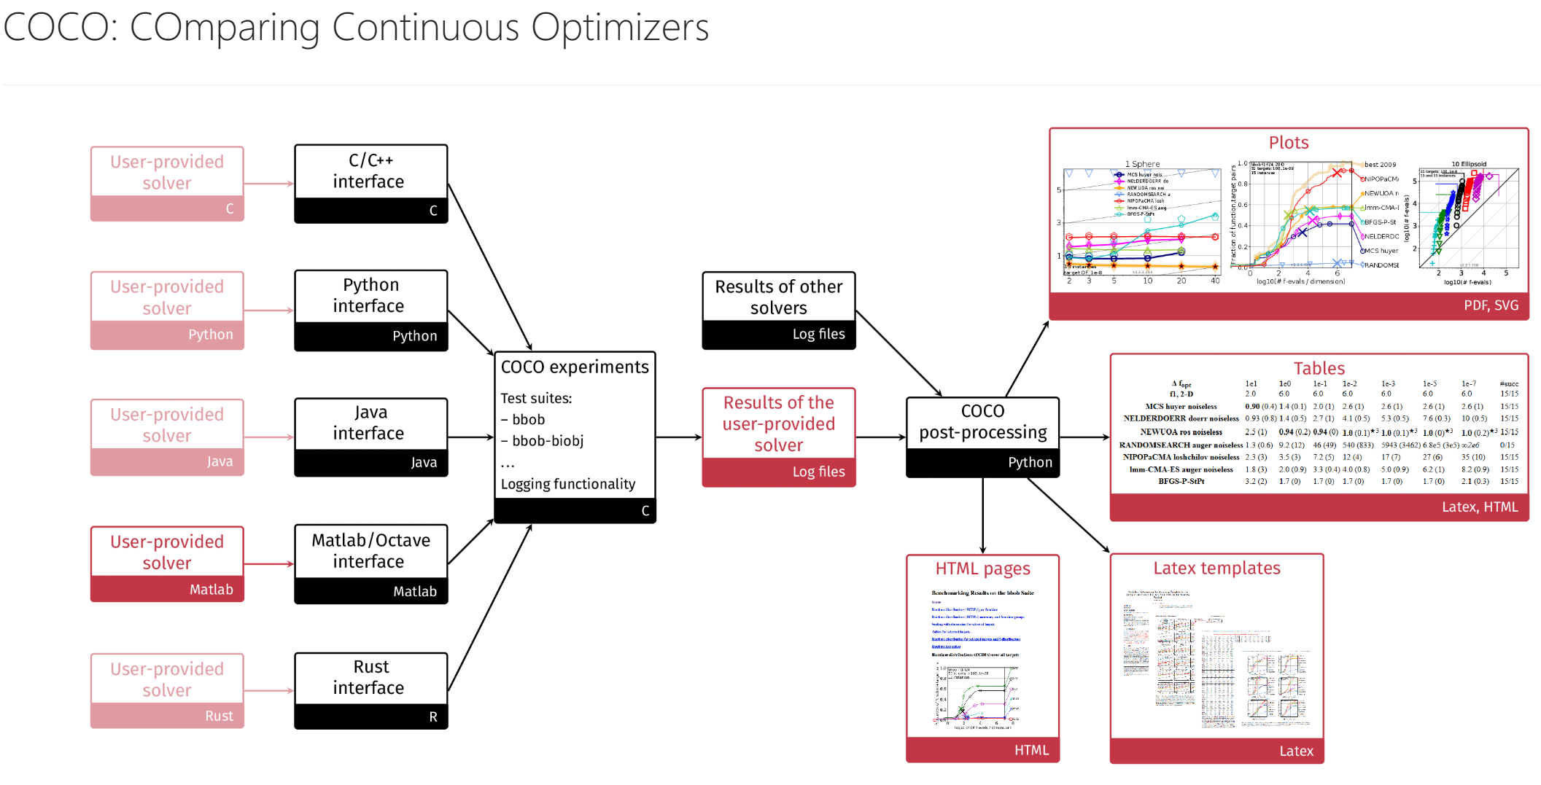
Why to use benchmark (test) functions for optimisation
Benchmark functions serves as a testbed for performance comparison of (meta/hyper)heuristic optimisation algorithms
Their global minimum are known
They can be easily computed
Each function is recognised to have certain characteristics potentially representing a different real-world problem
E.g. ,separable vs non-separable
COmparing Continuous Optimisers (COCO) provide benchmark function testbeds: https://numbbo.github.io/coco/

Slide 7
Classification of benchmark (test) functions
A common classification is:
Continuity (Differentiability)
Discontinuous vs continuous
Dimensionality
Scalability
Separability
Modality
Unimodal
Multimodal with few local minima
Multimodal with exponential number of local minima
A collection of unconstrained benchmark functions: https://arxiv.org/pdf/1308.4008.pdf
Notes:
The difficulty of a problem generally increases with its dimensionality. A function is scalable if it can be applied to any given dimensionality.
The separability is a measure of difficulty of different benchmark functions. In general, separable functions are relatively easy to solve, when compared with their inseperable counterpart, because each variable of a function is independent of the other variables. If all the parameters or variables are independent, then a sequence of independent optimization processes can be performed. As a result, each design variable or parameter can be optimized independently
In other words, a function of p variables is called separable, if it can written as a sum of p functions, each of just a single variable
By studying these functions, we learn not only how well our algorithms perform but also where they fail!

Slide 8


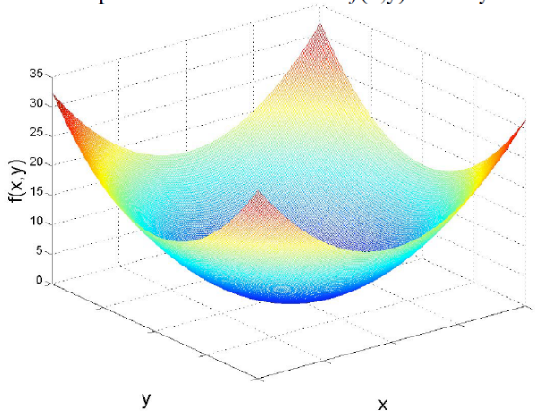

Example – unimodal function: Sphere function
continuous
differentiable
separable
scalable
n = 2

Slide 9
Delta Evaluation in Function Optimisation
Separable functions allows delta evaluation
Example, sphere function
x₄₃ x₄₃
x₁ … 6 … x_{n} ⇒ x₁ … 5 … x_{n}
f(s) = Σ ⇒ f(s') = Σ + Δ
(5² - 6²)
s
s'

Slide 10


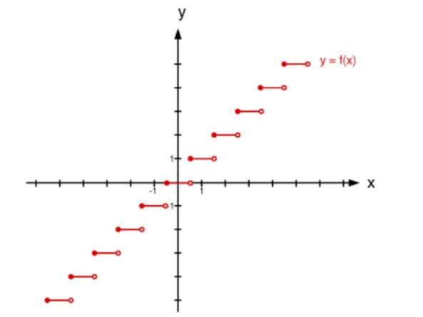

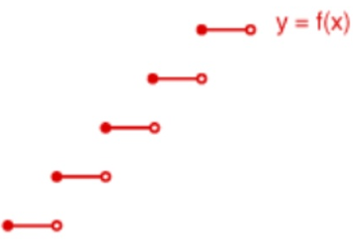



Example – unimodal function: Step function
discontinuous
Non-differentiable
separable
scalable
n = 1
-

Slide 11
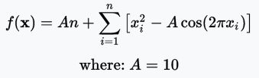
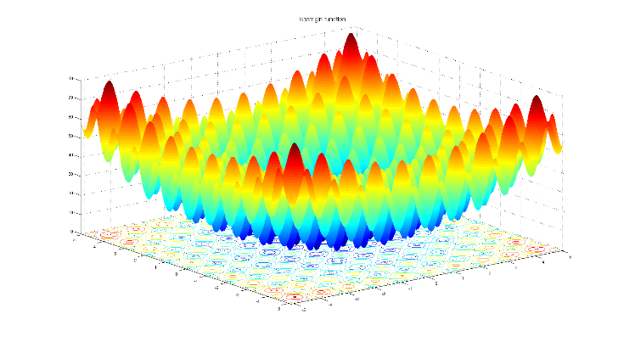


Example – multimodal function Rastrigin’s function
continuous
differentiable
separable
scalable
n = 2

Slide 12

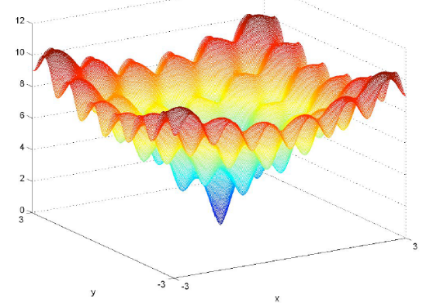

Example – multimodal function Ackley’s function
continuous
differentiable
non-separable
non-scalable
n = 2

Slide 13
Example – Sphere Function Optimisation
Objective:
Find the set of integers x_{i} which maximize the function f given below.
for n =3, f (x) = x₁²+x₂²+x₃²
-512 < x_{i} ≤ 512
Fitness function

Slide 14
Sphere Function Optimisation – Representation I
There are 1024 integers in the given interval -512 < x_{i} ≤ 512
In binary representation, 1024 different integers can be represented using 10 bits
Encoding of x_{i}
Decoding of x_{i}
0 : 0000000000 (-511)
1 : 0000000001 (-510)
... ...
1023 : 1111111111 (512)
Convert binary # into decimal, e.g., x_{i} = (0000000011) = 3
Subtract 511 from that value, e.g., 3-511 = -509

Slide 15
Sphere Function Optimisation – Representation II
Function has 3 parameters (dimensions): x₁, x₂, x₃
Each parameter can be represented by 10 bits
Chromosome consists of 30 bits
Example
110010101011000000000000000110
x₁ x₂ x₃

Slide 16
Sphere Function Optimisation – Fitness Evaluation (Decoding)
110010101011000000000000000110
x₁ x₂ x₃
x₁ = (810 - 511) = 299
x₂ = (768 - 511) = 257
x₃ = (6 - 511) = -505
Fitness: f(x) = (299)² + (257)² + (-505)²
= 410425
f (x) = x₁²+x₂²+x₃²

Slide 17
More on Function Optimization
What if x_{i} were real numbers in the interval
-5.12 < x_{i} ≤ 5.12
Solution:
Use binary representation
with precision of 2 digits after decimal point
use 1024 different numbers
divide number by 100
Use other representation (e.g. real)
What if the representation has redundancy?
e.g. -5.40 < x_{i} ≤ 5.40
Notes:
Efficiency: A good representation ensures that the algorithm explores and exploits the search space effectively.
Precision: The level of detail we can capture in solutions depends on how variables are represented.
Compatibility: The representation must work well with genetic operators like crossover and mutation.

Slide 18
Case Studies
Benchmark Function Optimisation
Ender Özcan, Burak Bilgin, Emin Erkan Korkmaz, A Comprehensive Analysis of Hyper-heuristics, Intelligent Data Analysis, 12:1, pp. 3-23, 2008. [PDF]

Slide 19
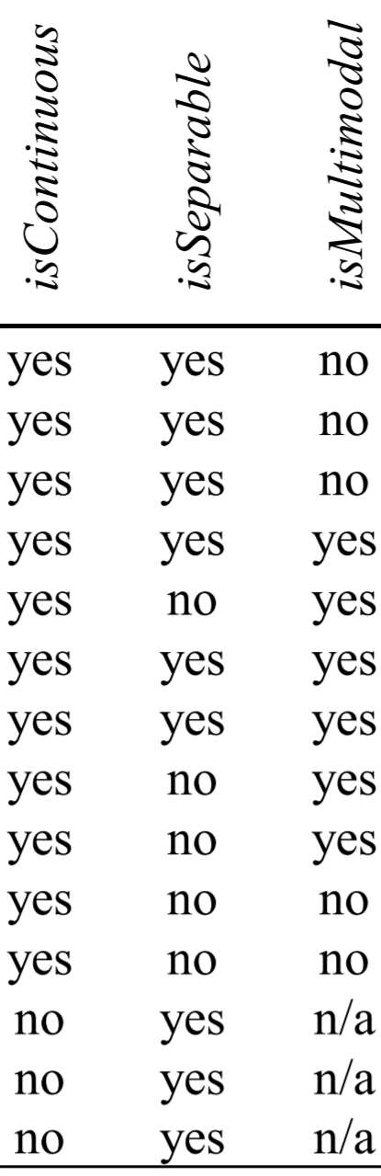
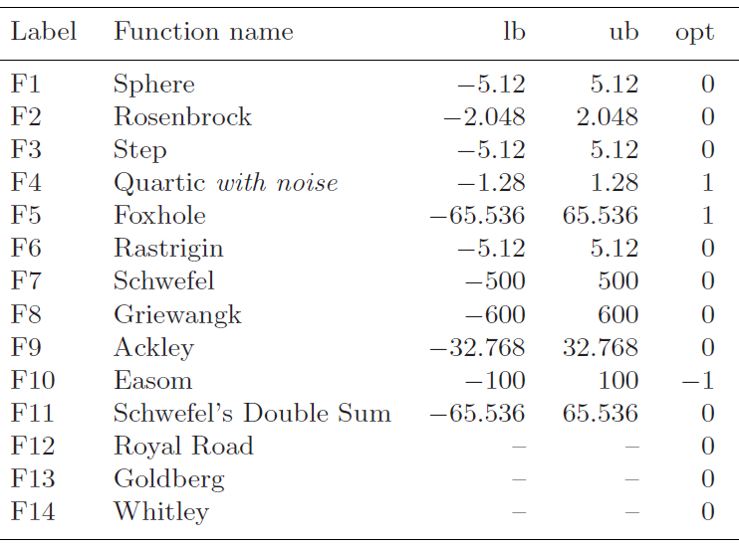
Benchmark Function Optimisation
http://www.cs.nott.ac.uk/~pszeo/docs/publications/IDA08.pdf

Slide 20
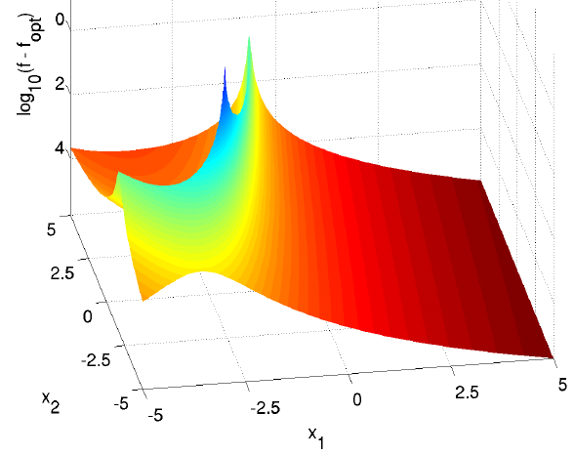
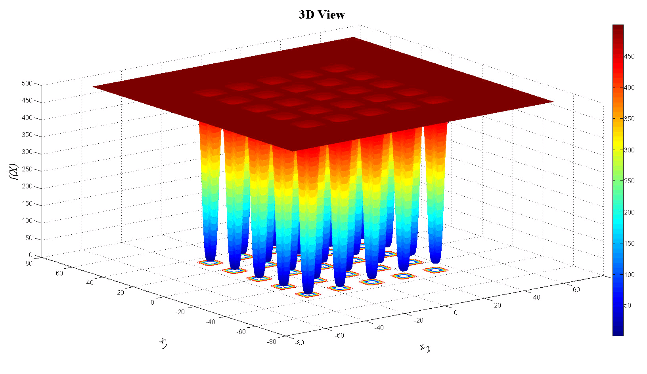
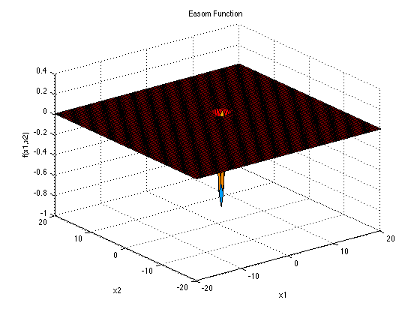
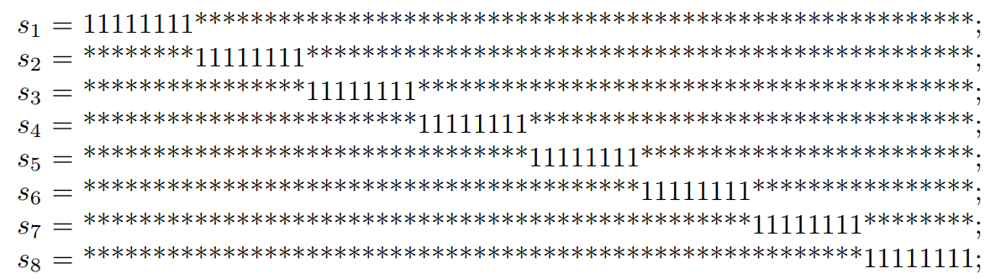
Benchmark Function Optimisation

Slide 21
Binary vs Gray Encoding
Gray encoding ensures a Hamming distance of 1 for the adjacent numbers
Shown to be useful in GAs empowering the algorithm to mutate a solution in the right direction
Dec Binary
0 000
1 001
2 010
3 011
4 100
5 101
6 110
7 111
Gray
000
001
011
010
110
111
101
100
Notes:
Encoding of numbers so that adjacent numbers have a single digit differing by 1
Gray Encoding is used to avoid the occurrences of Hamming Walls.
Basically A Hamming wall is a point at which it becomes rare or highly unlikely that the GA will mutate in exactly the right way to produce the next step in fitness.

Slide 22
Components of Evolutionary Algorithms and Settings
Representation: Gray encoding
Initialisation: random
Mate selection: Tournament with tour size of 2
Crossover: 1PTX (p_{c}=1.0)
Traditional mutation based on bit-flip with mutation rate 1/(2 x chromosome_length)
A trans-generational EA with a replacement method which keeps only two best individuals from the previous generation.

Slide 23
Components of Evolutionary Algorithms and Settings II
Memes (using bit-flip):
GA: Genetic Algorithm (none)
MA0: MA with SDHC (best imp.)
MA1: MA with NDHC (first imp.)
MA2: MA with RMHC
MA3: MA with DBHC
Expectedly, poor performing memes (using biased moves) are designed:
MA4: SDHC ⇒ neighborhood move: AND with 0
MA5: SDHC ⇒ neighborhood move: OR with 1
MA6: NDHC ⇒ neighborhood move: AND with 0
MA7: NDHC ⇒ neighborhood move: OR with 1

Slide 24
Termination and Performance Comparison Criteria
Termination: Runs are terminated whenever the overall CPU time exceeds 600 sec., or an expected fitness (optimum) is achieved.
Pentium IV 2 GHz. machines with 256 MB RAM are used
All runs are repeated 50 times.
Performance indicators:
Success rate (effectiveness): The ratio of the number of runs returning the expected optimal solution to the total number of runs (50)
Average number of evaluations/configurations (efficiency)
Bar chart plots showing the average no. of evaluations in log scale for each algorithm, if the success rate is 100% (all 50 runs yield expected optimum), otherwise no bar is drawn.

Slide 25

Results
Sphere
Rosenbrock
GA: Genetic Algorithm
MA0: MA with SDHC
MA1: MA with NDHC
MA2: MA with RMHC
MA3: MA with DBHC
Biased ones:
MA4: SDHC - AND with 0
MA5: SDHC - OR with 1
MA6: NDHC -AND with 0
MA7: NDHC - OR with 1
Step
Quartic with noise

Slide 26
Results II
Foxhole
Rastrigin
GA: Genetic Algorithm
MA0: MA with SDHC
MA1: MA with NDHC
MA2: MA with RMHC
MA3: MA with DBHC
Biased ones:
MA4: SDHC - AND with 0
MA5: SDHC - OR with 1
MA6: NDHC -AND with 0
MA7: NDHC - OR with 1
Schwefel
Griewangk

Slide 27
Results III
Ackley
Easom
GA: Genetic Algorithm
MA0: MA with SDHC
MA1: MA with NDHC
MA2: MA with RMHC
MA3: MA with DBHC
Biased ones:
MA4: SDHC - AND with 0
MA5: SDHC - OR with 1
MA6: NDHC -AND with 0
MA7: NDHC - OR with 1
Schwefel’s Double Sum
Royal Road

Slide 28
Results IV
Goldberg
Whitley
GA: Genetic Algorithm
MA0: MA with SDHC
MA1: MA with NDHC
MA2: MA with RMHC
MA3: MA with DBHC
Biased ones:
MA4: SDHC - AND with 0
MA5: SDHC - OR with 1
MA6: NDHC -AND with 0
MA7: NDHC - OR with 1

Slide 29
Summary
MA0 (SDHC) is the best meme choice for F4, F13 and F14. (noisy + deceptive)
MA1 (NDHC) is the best meme choice for F6-F8. (multimodal)
MA3 is (DBHC) the best meme choice for F2, F3, F5, F10, F12. (functions with plateaus)
For functions F1, F11 (unimodal) and F9, GA performs slightly better than the memetic algorithm with the meme MA1 (NDHC). The performance difference is insignificant.
In the overall, MA2 (RMHC) and MA3 (DBHC) turn out to be the worst and the best meme, respectively, among MA0-MA3, considering the success rates and average number of evaluations.
Different memes yield different performances, designing the right meme for the problem in hand is important.

Slide 30
Travelling Salesman Problem
E. Özcan, and M. Erenturk, A Brief Review of Memetic Algorithms for Solving Euclidean 2D Traveling Salesrep Problem, Proc. of the 13th Turkish Symposium on Artificial Intelligence and Neural Networks, pp. 99-108, June 2004. [PDF]

Slide 31
Binary Representation for Encoding Permutation
Binary representation and classical random initialisation, cross-over and mutation operators are not suitable for encoding permutation
E.g., for TSP, could cause illegal tours to form
not all cities visited
undefined city codes
cities visited more than once
loops formed within the tour
needs repair algorithms

Slide 32
Example
Given N=5 cities ⇒ 3 bits per city,
2 5 3 1 4
individual 1: 0|10 101 011 001 100
5 2 1 4 3
individual 2: 1|01 010 001 100 011
After applying 1-point crossover:
1 2 1 4 3
individual 1: 001 010 001 100 011
6 5 3 1 2
individual 2: 110 101 011 001100
2 | 5 3 1 4
5 | 2 1 4 3
2 2 1 4 3
5 5 3 1 4

Slide 33
Generic Permutation based Genetic Operators

Slide 34
Partially Mapped Crossover (PMX)
Builds offspring by
choosing a subsequence of a tour from one parent
choose two random cut points to serve as swapping boundaries
swap segments between cut points
preserving the order and position of as many cities as possible from other parent
Exploits important similarities in the value and ordering simultaneously

Slide 35
PMX
Example:
p1: (1 2 3 | 4 5 6 7 | 8 9)
p2: (4 5 2 | 1 8 7 6 | 9 3)
step 1: swap segments
o1: (x x x | 1 8 7 6 | x x)
o2: (x x x | 4 5 6 7 | x x)
this also defines mappings:
1⇔4, 8⇔5, 7⇔6, 6⇔7
step 2: fill in cities from other parents if no conflict
o1: (x 2 3 | 1 8 7 6 | x 9)
o2: (x x 2 | 4 5 6 7 | 9 3)
step 3: use mappings for conflicted positions
o1: (4 2 3 | 1 8 7 6 | 5 9)
o2: (1 8 2 | 4 5 6 7 | 9 3)

Slide 36
Order Crossover (OX)
Builds offspring by
choosing a subsequence of a tour from one parent
preserving relative order of cities from other parent
Exploits the property that ordering of cities important, not positions
9-3-4-5-2-1-8-7-6 and
4-5-2-1-8-7-6-9-3 are identical

Slide 37
OX
Example:
p1: (1 2 3 | 4 5 6 7 | 8 9)
p2: (4 5 2 | 1 8 7 6 | 9 3)
step 1: copy segments into offspring
o1: (x x x | 4 5 6 7 | x x)
o2: (x x x | 1 8 7 6 | x x)
step 2: starting from 2nd cut point of one parent, cities from other parent copied in same order, omitting symbols already present; if end of string reached, continue from beginning of string
sequence of cities in 2nd parent (from 2nd cut point) is
9-3-4-5-2-1-8-7-6 (remove 4,5,6,7 which are in 1st offspring)
9-3-2-1-8
place into first offspring o1: (2 1 8 | 4 5 6 7 | 9 3)
similarly the 2nd offspring o2: (3 4 5 | 1 8 7 6 | 9 2)

Slide 38
Cycle Crossover (CX)
Builds offspring by
choosing each city and its position from one of the parents
and when a cycle is completed, the remaining cities filled in from the other parent
Preserves absolute positions of the elements in the parent sequence

Slide 39
Cycle Crossover (CX)
p1: (1 2 3 4 5 6 7 8 9)
p2: (4 1 2 8 7 6 9 3 5)
Randomly select a starting point(city) in p1: 1
Copy cities from p1 until a cycle is obtained while mapping from p1 to each corresponding city in p2
o1: (1 x x x x x x x x)
o1: (1 x x 4 x x x x x)
o1: (1 x x 4 x x x 8 x)
o1: (1 x 3 4 x x x 8 x)
o1: (1 2 3 4 x x x 8 x)
so rest filled from other parent:
o1: (1 2 3 4 7 6 9 8 5)
similarly
o2: (4 1 2 8 5 6 7 3 9)

Slide 40
More Genetic Operators – Crossover for TSP
Operator Name Date Authors .
Alternating Position Crossover (AP) (1999) Larranaga, Kuijpers, Poza, Murga
Cycle Crossover (CX) (1987) Oliver, Smith and Holland
Distance Preserving Crossover (DPX) (1996) Freisbein and Merz
Edge Assembly Crossover (EAX) (1997) Nagata and Kobayashi
Edge Recombination Crossover (ER) (1989) Whitley, Timothy, Fuquay
Heuristic Crossover (HEU) (1987) Grefenstette
Inver-over Operator (IOO) (1998) Tao and Michalewicz
Maximal Preservative Crossover (MPX) (1988) Mühlenbein, Schleuter and Krämer
Position Based Crossover (POS) (1991) Syswerda
Order Crossover (OX1) (1985) Davis
Order Based Crossover (OX2) (1991) Syswerda
Partially mapped Crossover (PMX) (1985) Goldberg and Lingle
Voting Recombination Crossover (VR) (1989) Mühlenbein
Natural Crossover (NX) (2000) Jung and Moon
Voronoi Quantized Crossover (VQX) (2002) Seo and Moon

Slide 41
More Genetic Operators – Mutation for TSP
Operator Name Date Authors
Displacement Mutation (DM) (1992) Michalewicz
Exchange Mutation (EM) (1990) Banzhaf
Insertion Mutation (ISM) (1988) Fogel
Inversion Mutation (IVM) (1990) Fogel
Scramble Mutation (SM) (1991) Syswerda
Simple Inversion Mutation (SIM) (1975) Holland

Slide 42
GA vs MA for Solving TSP Experiments – Components
Representation: path representation (permutation)
For example, (1 3 5 2 6 4) represents a tour starting from city 1, visiting 3, 5, 2, 6, 4 in that order and returning back to 1.
Fitness function: path length
Crossover: PMX, 2PTX (with repair/patch-up), OX
Mutation Operators: ISM, EM,
Mate Selection: RANK, TOUR
Replacement: TG, SS
Hill Climbing: RMHC using ISM, RMHC using EM
A hill climbing step is applied, as long as, max. number of iterations is not exceeded and the indiv. is improved.
Notes:
Deleted RAND for rank selection

Slide 43



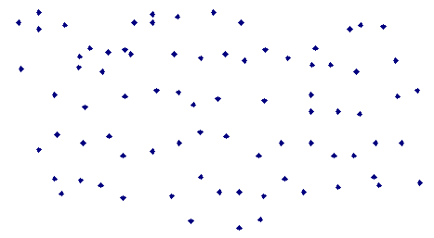
Experimental Data
α = 2π/N
F32
F41
C20/30/40
T81
S21

Slide 44
Results
From the best to worst, considering the average fitness per generation at each run (100 runs)
Crossover: OX1, 2PTX, PMX
Mutation: EM, ISM (ISM is better in finding the best), 1/chromosome-lenght
Mate Selection: TOUR (tour-size:2), RANK
Replacement: TG (keep top 2 and replace the rest with offspring, g=popSize-2), SS (replace the worst pair of individuals with the best pair among the offspring and parents)
Approach: MA (Hill Climbing: EM, ISM), GA
α: avr. fitness per generation at each run
β: best fitness across 100 runs
Notes:
Deleted RAND for mate selection

Slide 45
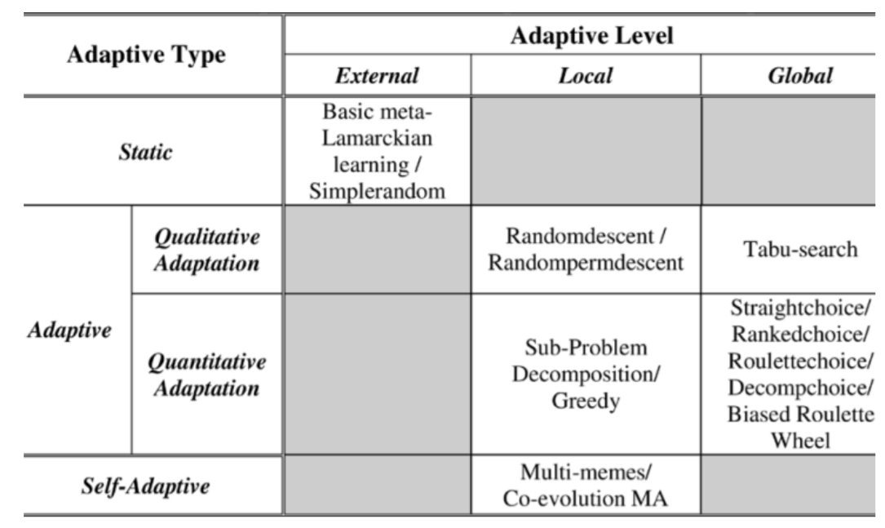
A Classification of Memetic Algorithms
Yew-Soon Ong; Meng-Hiot Lim; Ning Zhu; Kok-Wai Wong, "Classification of adaptive memetic algorithms: a comparative study," Systems, Man, and Cybernetics, Part B: Cybernetics, IEEE Transactions on , vol.36, no.1, pp.141,152, Feb. 2006 [PDF]

Slide 46
Multimeme Memetic Algorithms

Slide 47
Self Adaptation for Genetic Operators
Self Adaptation: Deciding which operators and settings to use on the fly whenever needed receiving feedback during the evolutionary search process
Davis used varying probabilities of applying different operators
Uses the performance of the operator within the last few generations to update probabilities
Grefenstette, Kakuza, Friesleben, Hartfelder used subpopulations, each having different set of parameters and operators
Spears used an additional bit to decide whether apply 2-PTX or UX to an individual (co-evolution)

Slide 48
Multimeme Memetic Algorithms
Introduce memetic material for each individual
Co-evolve genetic and memetic material
Krasnogor formalised in his PhD thesis*.
A meme encodes how to apply an operator (which one to apply, max. no. of iterations, acceptance criteria), when to apply, where to apply, and how frequent to apply
Meme of each operator can be combined under a memeplex
*Krasnogor N (2002) Studies on the theory and design space of memetic algorithms, PhD Thesis, University of the West of England, Bristol, UK

Slide 49
Grammar for a Memeplex– Compound of Memes
Memeplex = <Meme>;<Meme>:<Memeplex>
Meme = (< Where >, < When >, < How >, < Frequency >)
Where = < Location > Crossover ; < Location > Mutation;
Location = After ; Before
When = < BooleanCondition >
How = GeneralHillClimber < Move >< Strategy >< Iterations >; BoltzmanAdaptiveHillClimber < Move >< Strategy >< Iterations > …
Frequency = Always; For < Iterations >; Never …
Move = 2-exchange, 3-exchange
Strategy = NextAscent; SteepestAscent; MiniMax < Size >; MaxiMin < Size >
Size = < Num >
Iterations = < Num >

Slide 50
Multimeme Memetic Algorithms – Features
Memes represent instructions for self-improvement
Specify set of rules, programs, heuristics, strategies, behaviors, etc.
Interaction between memes and genes are not direct
Mediated by individual (genetic and memetic material)
Memes can evolve, change by means of nontraditional genetic transformations and metrics

Slide 51
Examples – Implementation
genetic material
memetic material
MAX-SAT: (1 0 0 0 1 + 2 )
Hc (hill climbing operator)→ 0: RMHC, 1: SDHC, 2: NDHC
TSP:(4 5 2 1 8 7 6 9 3 + 2 1 1 2 0 1 1 2)
Mp (mutation probability) → 0: 2/n, 1: 1/n, 2: 1/(2xn), 3: 0.1,…
Mo (mutation operator) → 0: Exchange, 1: Insertion,…
Cp (crossover probability) → 0: 1.0, 1: 0.95, 2: 0.90,…
Co (crossover operator) → 0: 1PTX+repair, 1: OX, 2: CX,…
W (where to apply HC) → 0: After Mutation, 1: After Crossover,…
Hc (strategy/how to apply HC) → 0: first impr., 1: best improvement,…
Hs (move/HC step)→ 0: Exchange, 1: Adjacent interchange,…
I (frequency/number of HC iterations) → 0: n, 1: 2n , 2: 4n, 3: 8n,…
memeplex: Hc2 (Hc: meme and 2:meme option)
Mp2Mo1Cp1Co2W0Hc1Hs1I2
#1
#2
#3
memes
meme options

Slide 52
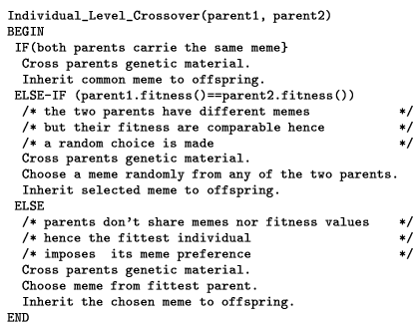
Inheriting Memetic Material – SIM
(1 0 0 0 1 + Hc1Hs1I2) f =2
(1 1 0 1 1 + Hc0Hs4I1) f =1
(1 1 0 0 1 + Hc0Hs4I1)
(1 0 0 1 1 + Hc0Hs4I1)
Krasnogor N, Smith JE (2001) Emergence of profitable search strategies based on a simple inheritance mechanism. In: Proc of the Genetic and Evolutionary Comp. Conf., pp 432–439
http://eprints.uwe.ac.uk/11088/1/11088.pdf

Slide 53
Mutating Memes during Evolution
Inovation rate (IR) ∈[0,1], is the probability of mutating the memes
Mutation randomly sets the meme option to one of the other options
MAX-SAT: (1 0 0 0 1 + Hc2 ) → 0: (1 0 0 0 1 + Hc0)
TSP: (4 5 2 1 8 7 6 9 3 + Mp2Mo1Cp1Co2W0Hc1Hs1I2) →
(4 5 2 1 8 7 6 9 3 + Mp0Mo2Cp0Co1W1Hc3Hs0I4)
IR=0; no innovation, if a meme option is not introduced in the initial generation, it will not be reintroduced again
IR=1; All different strategies implied by the available M memes might be equally used.

Slide 54
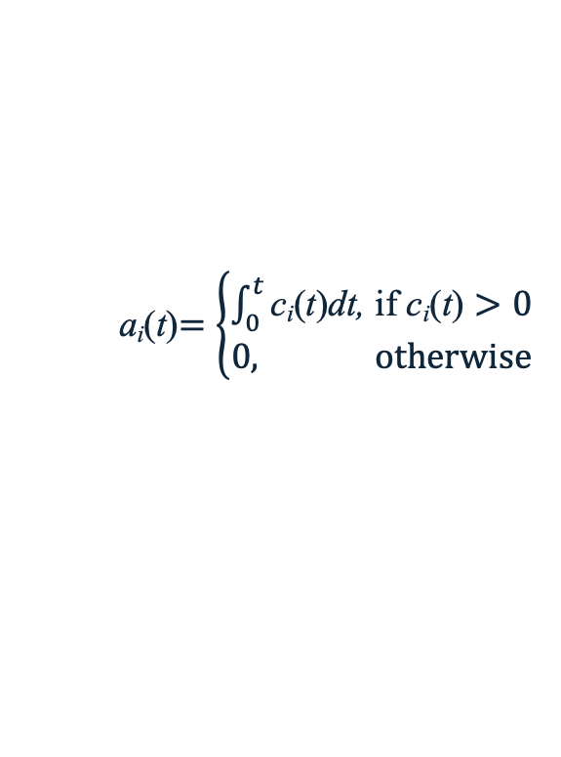
Measure for Evaluating Meme Performance
Concentration of a meme (c_{i}(t)) is the total number of individuals that carry the meme i at a given generation t,
Crude measure of a meme success; gives no information about continual usage of a meme
Evolutionary activity of a meme (a_{i}(t)) is the accumulation of meme concentration until a given generation,
Slope in a plot represents the rate of increase of a meme concentration
a_{i}(t)$=\left\{\begin{aligned}\int_{0}^{t}{\text{c}\text{i}\text{(}\text{t}\text{)}\text{dt}\text{,} \text{if} \text{c}\text{i}\text{(}\text{t}\text{)}>0} \\ 0, otherwise\end{aligned}\right.$

Slide 55
Memetic Algorithms (MAs)
gene
15.0
Generate Initial Population
28.0
7.0
Evaluate All Individuals
9.0
7.0
Select Mates (Parents)
9.0
no
Terminate?
yes
Crossover
Mutate
16.0
11.0
Evaluate All Children
6.0
Hill Climbing
10.0
6.0
Form Next Generation
7.0
9.0
10.0

Slide 56
Multimeme Memetic Algorithms (MMAs)
meme(plex)
Meme options
h₄
15.0
Generate Initial Population
h₃
28.0
h₁
h₂
h₂
7.0
Evaluate All Individuals
h₁
9.0
h₄
h₃
h₂
7.0
Select Mates (Parents)
h₁
9.0
no
h₂
Terminate?
yes
h₁
Crossover
h₂
h₂
Mutate
h₂
16.0
h₃
11.0
Evaluate All Children
h₂
6.0
Hill Climbing
h₃
10.0
h₂
6.0
Form Next Generation
h₂
7.0
h₁
9.0
h₃
10.0

Slide 57
Benchmark Function Optimisation - revisited
Ender Özcan, Burak Bilgin, Emin Erkan Korkmaz, A Comprehensive Analysis of Hyper-heuristics, Intelligent Data Analysis, 12:1, pp. 3-23, 2008. [PDF]

Slide 58
MMA Experiments for Benchmark Function Optimisation – Additional Settings
IR rate is fixed as 0.20
Two sets of experiments are performed
A single good meme and two poor performing memes are used to test the power of MMAs in identifying the good ones.
Memes GA, MA0, MA1, MA2 and MA3 are used to observe whether MMA will provide some type of synergy between memes.

Slide 59
Results
Sphere
Rosenbrock
GA: Genetic Algorithm
MA0: MA with SDHC
MA1: MA with NDHC
MA2: MA with RMHC
MA3: MA with DBHC
Biased ones:
MA4: SDHC - AND with 0
MA5: SDHC - OR with 1
MA6: NDHC -AND with 0
MA7: NDHC - OR with 1
Step
Quartic with noise

Slide 60
MMA 1.a
Good meme (GA) followed by two poor performing memes
GA (expected – good meme)
MA3
GA (observed)
MA3
GA: Genetic Algorithm
MA0: MA with SDHC
MA1: MA with NDHC
MA2: MA with RMHC
MA3: MA with DBHC
Biased ones:
MA4: SDHC - AND with 0
MA5: SDHC - OR with 1
MA6: NDHC -AND with 0
MA7: NDHC - OR with 1
MA0
MA3
MA0
MA3

Slide 61
MMA 1.b
MA1
MA1
MA1
MA1
GA: Genetic Algorithm
MA0: MA with SDHC
MA1: MA with NDHC
MA2: MA with RMHC
MA3: MA with DBHC
Biased ones:
MA4: SDHC - AND with 0
MA5: SDHC - OR with 1
MA6: NDHC -AND with 0
MA7: NDHC - OR with 1
MA1
GA
MA1
GA

Slide 62
MMA 1.c
MA3
MA3
MA3
MA3
GA: Genetic Algorithm
MA0: MA with SDHC
MA1: MA with NDHC
MA2: MA with RMHC
MA3: MA with DBHC
Biased ones:
MA4: SDHC - AND with 0
MA5: SDHC - OR with 1
MA6: NDHC -AND with 0
MA7: NDHC - OR with 1
MA0
MA0
MA0
MA0

Slide 63
MMA 2 Experiments – Synergy Between Memes
Second entry for each function indicates the best performing hill climbing under the generic MA framework where HC is applied after mutation

Slide 64
MMA 2.a
Memes are fixed
MA3 (expected)
MA0
MA3 (observed)
MA0
GA: Genetic Algorithm
MA0: MA with SDHC
MA1: MA with NDHC
MA2: MA with RMHC
MA3: MA with DBHC
Biased ones:
MA4: SDHC - AND with 0
MA5: SDHC - OR with 1
MA6: NDHC -AND with 0
MA7: NDHC - OR with 1
MA1
MA1
MA3
MA1

Slide 65
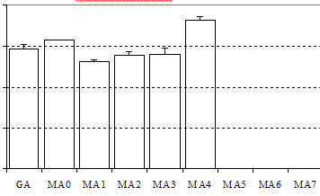
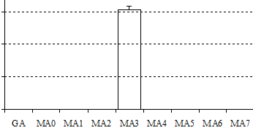
MMA 2.b
F7
F10
MA1
MA1
MA3
MA1
GA: Genetic Algorithm
MA0: MA with SDHC
MA1: MA with NDHC
MA2: MA with RMHC
MA3: MA with DBHC
Biased ones:
MA4: SDHC - AND with 0
MA5: SDHC - OR with 1
MA6: NDHC -AND with 0
MA7: NDHC - OR with 1
MA1
MA3
MA3
MA3

Slide 66
MMA 2.c
MA0
MA0
MA0
MA0
GA: Genetic Algorithm
MA0: MA with SDHC
MA1: MA with NDHC
MA2: MA with RMHC
MA3: MA with DBHC
Biased ones:
MA4: SDHC - AND with 0
MA5: SDHC - OR with 1
MA6: NDHC -AND with 0
MA7: NDHC - OR with 1

Slide 67
Results
Average evolutionary activity plots show that the multimeme approach successfully identifies useful memes.
Even if there are useless operators in the system
Any hill climber seems to attain the optimum fast for F1, F3 and F11 under any setting
In all runs full success is achieved for all cases.

Slide 68
Results II
MMA can identify the best meme or a meme that does not perform significantly better than the best meme for almost each benchmark function
Comparing the experimental results obtained using MMA and MA with the best meme for each benchmark function indicate that MA with the best meme is superior based on the average number of evaluations, except for F1, F3, F9 and F11
Learning is time consuming hence there is a trade-off

Slide 69
Overall Summary…

Slide 70
Weaknesses of Evolutionary Algorithms
Limited theoretical and mathematical analyses – this is a growing field of study
Schema theorem and building block hypothesis
Markov chain analysis
Chaos theory
Martingale theory (for convergence analysis)
Runtime analysis with respect various parameter settings (e.g., expected runtime analysis based on fitness levels/partitions, drift analysis)
Per Kristian Lehre and Pietro S. Oliveto, GECCO 2021, Runtime Analysis of Evolutionary Algorithms: Basic Introduction
Considered slow for online applications and for some large offline problems
Speedy hardware
Parallel/distributed processing

Slide 71
Overall Summary
Genetic Algorithms represent a subclass of nature inspired Evolutionary Computation Techniques
GAs creates an initial population of individuals and performs the search by applying selection, crossover and mutation on individuals at each evolutionary cycle
GA components including the parameter settings require careful tailoring to the problem in hand
Memetic Algorithms hybridise GAs with Hill Climbing
There is a variety of benchmark functions used for performance comparison of search algorithms
In general, a memetic algorithm performs better than a genetic algorithm
Choice of meme (operators and their settings) along with the encoding influence the performance of a memetic algorithm

Slide 72
Overall Summary (cont.)
Multimeme Algorithm can indeed learn how to choose an operator and relevant settings through the evolutionary process (co-evolution)
There is a trade-off as learning requires time and a memetic algorithm with a single setting could perform better
If there is limited number of operators and settings MMA can be used. If the number of operators and settings are large then additional analyses and methods could be needed to reduce the number of options leading to an MMA with improved performance
There is no single recipe for even choosing the set of memes while designing a memetic algorithm for solving a given problem.
Synergy between memes/meme components could be possible

Slide 73
Thank you Any questions?

